Slide 1
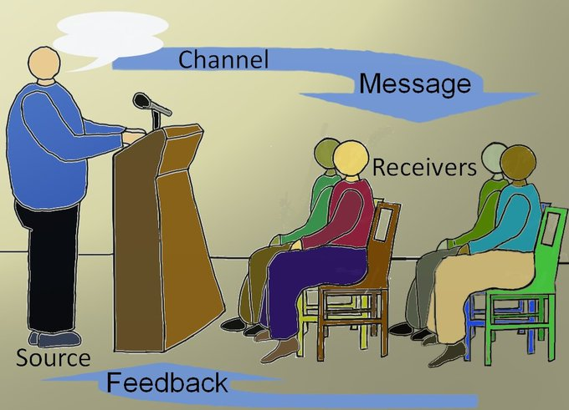
Chapter 4:
Verbal Messages

Slide 2
Introduction
People tend to interpret the same message in different ways and there are many reasons for such different interpretations which can lead to serious misunderstandings that affect our relationships.
So here we are going to describe the relationship between language and meaning and learn suggestions for improving our verbal communication.

Slide 3
Language
All languages are based on exchanging utterances.
Exchanging utterances is known as turn-taking.
We use language to label, compare, and define.
We also use language to compare and judge things as better or worse.
We also use language to learn from the experiences of others. We might do so by taking a course, attending a lecture or visiting a friend, watching a TV program.

Slide 4
What is a Language?
A language is a system of symbols used by people to communicate.
They are comprised of
(i) lexicon: a collection of words and expressions
(ii) phonology: sounds used to pronounce words
(iii) syntax and grammar: rules for combining words to form sentences.

Slide 5
Language Community
All people who understand a particular language are a part of a language community (people of Australia, England, Scotland, Ireland and the USA belong to the same language community as they speak English).
The five largest language communities in the world are Chinese, Spanish, English, Arabic and Hindi.
If people in a particular language community knew all the words (lexicon) and pronounce them the same way (phonology) and use the same rules of grammar and syntax, communication would be easy. But, this is not the case. The English spoken in England is not the same as spoken in the Unites States or anywhere else.

Slide 6
Dialect and Idiolect
Dialect
Languages are really collection of dialects. A dialect is a unique form of a more general language spoken by a specific culture or co-culture. These smaller groups that speak a common dialect are known as speech communities.
What is called a language and what is called a dialect are usually rooted in politics.
Idiolect
In addition to language and dialect, each of us uses our own personal symbol system called an idiolect which includes our active vocabularies and our unique pronunciations, grammar and syntax.

Slide 7
Characteristics of Language
Sharing meaning can be difficult because language is arbitrary, abstract, and constantly changing.
1. Language is arbitrary. The words used to represent things in any language are arbitrary symbols. Different language communities use different word symbols to represent the same phenomenon.
2. Language is abstract.
3. Language changes over time. New words are constantly being invented and existing words abandoned or assigned new meanings.

Slide 8
The Relationship Between Language and Meaning
As the meanings of the words can change over time, we must consider not only the words themselves but also how they are used in conversational, social and cultural contexts.
Semantics
Semantic meaning is derived from the words themselves and how they are arranged into sentences. Identifying the meaning of a word is tricky because actually have two types of meanings.
Denotation and Connotation
Denotation is the explicit meaning found in the dictionary of a language community. Connotation is the implicit additional meaning we associate with a word.

Slide 9
Guidelines for Improving Semantics
To improve semantics, choose words and arrange them in ways that both improve clarity and demonstrate respect. This can be done by using specific, concrete and familiar words and by using descriptive details and examples and by demonstrating linguistic sensitivity.

Slide 10
Pragmatics
Pragmatic meaning comes from interpreting a message related to the conversational context of it. Whereas, semantic meaning focuses on what words mean. Pragmatic meaning focuses on what people mean. So, pragmatic meaning changes across speakers and situations.
A speech act is the utterance of a verbal message by a speaker and what it implies about how the listener should respond. (Example page 74)

Slide 11
Guidelines for Improving Pragmatics
Tell the truth.
Provide the right amount of information.
Relate what you say to the topic.
Acknowledge when your message violates a guideline.
Assume the best first.

Slide 12
Sociolinguistics
Sociolinguistic meaning varies according to the norms of a particular culture or co-culture. Sociolinguistic misunderstandings occur when we interact with someone who operates using different norms.

Slide 13
Guidelines for Improving Sociolinguistic Understanding
Develop intercultural competence.
Practice mindfulness.
Respect and adapt to the sociolinguistic practices of others.

